Slide 1

Basic Proof Technique
Masnoon Muztahid
Lecturer, Dept. of CSE
United International University
Courtesy: Charles Aunkan Gomes, Minhajul Bashir

Slide 2
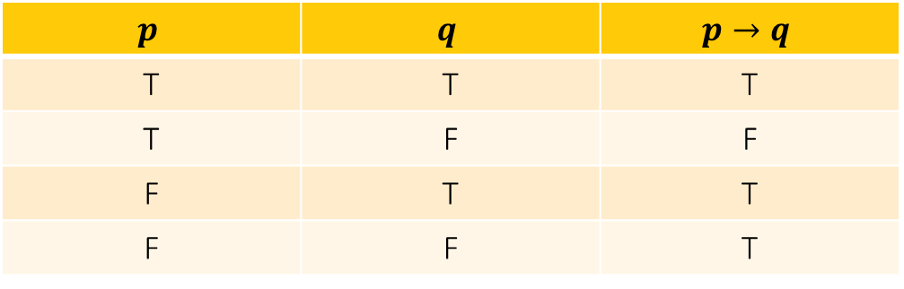
Vacuous Proof
If we prove a conditional statement by disproving its hypothesis, then the proof technique is called vacuous proof
$$p$$ | $$q$$ | $$p→q$$
T | T | T
T | F | F
F | T | T
F | F | T

Slide 3
Vacuous Proof (Example)
Prove that P(0) is true, where P(n) ≡ (n > 1) → (n² > n).
Answer:
Given, P(n) ≡ (n > 1) → (n² > n)
Substituting n = 0,
P(0) ≡ (0 > 1) → (0² > 0)
    ≡ (False) → (0² > 0)
Since the hypothesis is always False, the conditional statement is always True.
Therefore, P(0) is True.

Slide 4
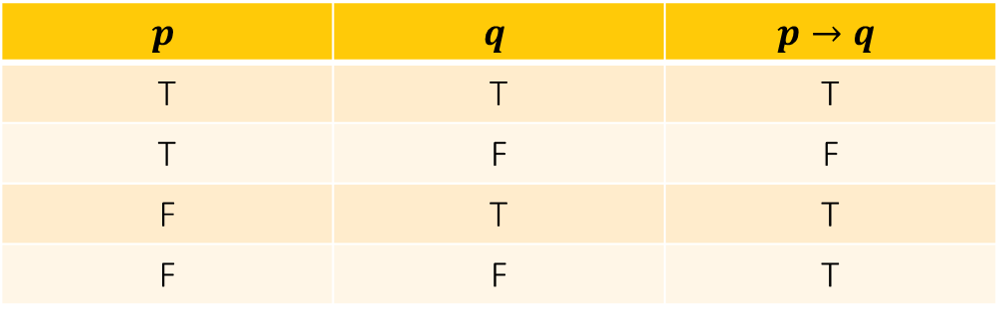
Trivial Proof
If we prove a conditional statement by proving its conclusion,
then the proof technique is called trivial proof.
$$p$$ | $$q$$ | $$p→q$$
T | T | T
T | F | F
F | T | T
F | F | T

Slide 5
Trivial Proof (Example)
Prove that P(0) true, where P(n)≡∀a∀b((a≥b)→(a^{n}≥b^{n}))
Answer:
Given, P(n) ≡ ∀a∀b((a ≥ b) → (aⁿ ≥ bⁿ))
Substituting n = 0,
P(0) ≡ ∀a∀b((a ≥ b) → (a⁰ ≥ b⁰))
Since a⁰ = 1 and b⁰ = 1,
= ∀a∀b((a ≥ b) → (1 ≥ 1))
= ∀a∀b((a ≥ b) → True)
Since the conclusion is always True, the conditional statement is always True. Therefore, P(0) is True.

Slide 6
Question: Consider the proposition,
P(n): If a and b are positive real numbers, then (a + b)ⁿ ≥ aⁿ + bⁿ.
Prove that P(1) is true. What kind of proof did you use?
Answer:
Given, P(n) ≡ (a + b)ⁿ ≥ aⁿ + bⁿ
Substituting n = 1,
P(1) ≡ (a + b)¹ ≥ a¹ + b¹
≡ a + b ≥ a + b
Since both sides are equal, the conclusion is always True.
Therefore, P(1) is True.
Type of Proof: Trivial Proof.

Slide 7
Question: Let x be a real number. By trivial proof, prove that “if x > 10, then x² + 1 > 0”.
Answer:
Given, P(x) ≡ (x > 10) → (x² + 1 > 0)
Since x is a real number, the square of any real number is always non-negative. Therefore, x² ≥ 0
Adding 1 to both sides, x² + 1 ≥ 1
Since 1 > 0, x² + 1 > 0.
Thus, the conclusion is always True, regardless of the hypothesis (x > 10).
Therefore, P(x) is True.
Type of Proof: Trivial Proof.

Slide 8
Proof Techniques
Three basic techniques:
Direct proof
Proof by contradiction
Proof by contraposition

Slide 9
Direct Proof
A direct proof is a logical argument where you start with the given assumptions (or premises) and apply a series of deductive steps to arrive at the conclusion.
First step is a premise
Subsequent steps use rules of inference or other premises
Last step proves the conclusion

Slide 10
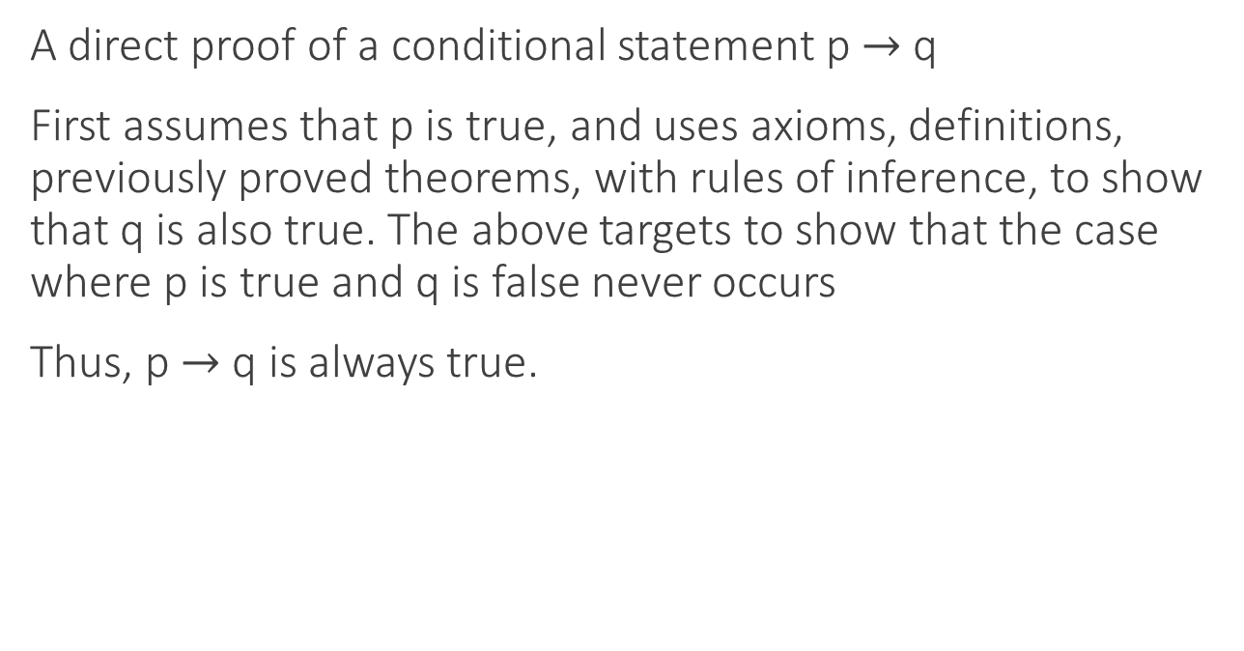
Direct Proof
A direct proof of a conditional statement p $→$ q
First assumes that p is true, and uses axioms, definitions, previously proved theorems, with rules of inference, to show that q is also true. The above targets to show that the case where p is true and q is false never occurs
Thus, p $→$ q is always true.

Slide 11
Direct Proof (Example)
Give a direct proof of the theorem "If n is an even integer, then n² is even.”
Assume that n is an even integer. This implies that there is some integer k such that, n = 2k
Then,
n² = (2k)²
= 4k²
= 2(2k²)
Since n² can be written as 2 times of an integer which is even, it follows that n² is even. _{[proved]}

Slide 12
Direct Proof (Example)
Give a direct proof that if m and n are both perfect squares, then mn is also a perfect square.(A perfect square is the square of an integer)
Assume that m and n are both squares. This implies that there are integers u and v such that,
m = u² and n = v².
Then,
mn = u² v²
= (uv)²
Notice that (uv)² is the square of the integer u . v.
Thus, mn is a perfect square._{[proved]}

Slide 13
Direct Proof (Example)
Prove that the product of two rational numbers is rational
Note: A real number r is rational if there exist integers p and q with q ≠ 0 such that r = p/q. A real number that is not rational is called irrational.

Slide 14
Direct Proof (Example)
Assume a and b are rational numbers. By definition of rational numbers, there exist integers p,q,r,s with q≠0 and s≠0 such that:
Then, and
ab = .
=
Notice that pr and qs are both integers because the product of integers is an integer.
Also, qs ≠ 0 because neither q nor s is zero.
Therefore, (pr)/(qs) is in the form
integer/nonzero integer , which is the definition of a rational number.
Thus, the product of two rational numbers is rational_{[proved]}
p
q
r
s
p
q
r
s
pr
qs

Slide 15
Proof by Contraposition
To prove p→q, we first assume that ¬q is true, and hence prove that ¬p is true
We actually prove the contrapositive of the actual sentence, i.e. ¬q→¬p
Why? Sometimes, it may be easier to directly prove ¬q→¬p than p→q

Slide 16
Proof by contraposition(Example)
We have to prove is if n² is odd, then
n is odd.
Suppose,
p= n² is odd and q= n is odd
n² is odd → n is odd
∴ p→q
Contrapositive of the original statement is, ¬q→¬p
≡ ¬(n is odd) → ¬(n² is odd)
≡ n is even → n² is even
If n is even, we can say n=2k
Then,
n² = (2k)²
= 4k²
= 2(2k²)
Since n² can be written as 2 times an integer, it follows that n² is even.
Since the contrapositive is true, the original statement is also true. Thus, we have proved that if n is an integer and n² is odd, then n is odd_{[proved]}

Slide 17
Proof by contraposition(Example)
If 3n + 2 is an odd integer, then n is odd.
Suppose,
p= 3n + 2 is odd and q= n is odd
3n + 2 is odd → n is odd
∴ p→q
Contrapositive of the original statement is, ¬q→¬p
≡ ¬(n is odd) → ¬(3n + 2 is odd)
≡ n is even →3n + 2 is even
If n is even, we can say n=2k
Then,
3n + 2 = 3 (2k) + 2
= 6k+2
= 2(3k+1)
Since 3n + 2 can be written as 2 times an integer, it follows that 3n + 2 is even.
Since the contrapositive is true, the original statement is also true. Thus, we have proved that if 3n + 2 is an odd integer, then n is odd_{[proved]}

Slide 18
Proof by Contradiction
Proof by contradiction is a logical method used to prove a statement by assuming the opposite (negation) of the statement is true and then demonstrating that this assumption leads to a contradiction. Since a contradiction indicates that the assumption must be false, the original statement is therefore proven to be true.
For statements of the form "if ( p ), then ( q )":
Assume p is true and q is false (¬q ).
Show that assuming ¬q leads to a situation where p cannot be true.
This creates a contradiction since we started by assuming p is true.
Therefore, our assumption that p is true and q is false must be incorrect.
Consequently, when p is true, q must also be true.

Slide 19
Proof by Contradiction(Example)
Give a proof by contradiction of the theorem "If n is an integer and 3n + 2 is even, then n is even"
Given, (3n+2) is even. We assume that n is not even, that is n is odd. If n is odd, there is some integer k such that, n=2k+1.
Then, 3n+2 = (3(2k+1)+2)=6k+3+2 = 6k+5
Since 6k is obviously even (because 6 is even and any integer multiplied by an even number is even), adding 5 (an odd number) to an even number results in an odd number.
Thus 3n+2 turned out to be odd. This contradicts our assumption that 3n+2 is even.
Since assuming that n is odd leads to a contradiction, our initial assumption must be incorrect.
Therefore, n must be even when 3n+2 is even.[proved]

Slide 20
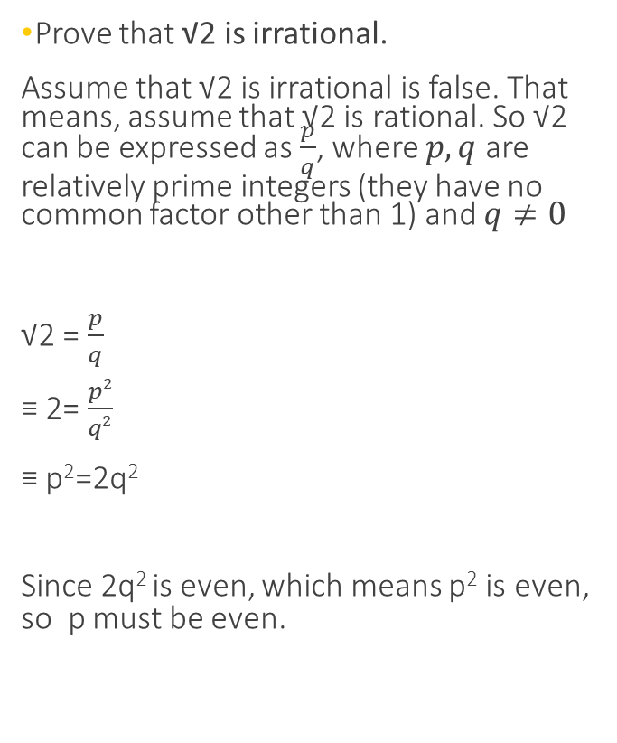
Prove by Contradiction (Example)
Prove that √2 is irrational.
Assume that √2 is irrational is false. That means, assume that √2 is rational. So √2 can be expressed as $\frac{p}{q}$, where $p,q$ are relatively prime integers (they have no common factor other than 1) and $q≠0$
√2 = $\frac{p}{q}$
≡ 2= $\frac{p2}{q2}$
≡ p²=2q²
Since 2q² is even, which means p² is even, so p must be even.
Hence, p=2k
≡ p² =(2k)² = 4k²
≡2q² = 4k²
≡ q²= 2k²
2k² is even, which means q² is even, so q must be even.
We have now concluded that both p and q are even, so they have a common factor of 2. Since our assumption that √2 is rational leads to a contradiction, we must conclude that √2 is irrational._{[proved]}

Slide 21
Which Proof Technique to Choose?
Try direct proof first
If you get stuck, try an indirect approach
  If conditional statement, use either contraposition or contradiction
  If not conditional statement, use contradiction

Slide 22
Question: Prove the following statement using an appropriate proof technique: “If a and b are two odd integers, then the sum of the squares of a and b is even.”
Answer: Direct Proof
Given, a and b are two odd integers. By the definition of odd integers, there exist integers m and n such that, a = 2m + 1 and b = 2n + 1
Now,
a² + b² = (2m + 1)² + (2n + 1)²
= (4m² + 4m + 1) + (4n² + 4n + 1)
= 4m² + 4m + 4n² + 4n + 2
= 2(2m² + 2m + 2n² + 2n + 1)
Since m and n are integers, (2m² + 2m + 2n² + 2n + 1) is an integer.
Therefore, a² + b² can be written as 2 times an integer. Hence, the sum of the squares of a and b is even. [Proved]

Slide 23
Question: Prove the following statement using an appropriate proof technique: “If n is an integer and n is even, then 10n² + 8n + 2 is even.”
Answer: Direct Proof
Given, n is even.
By the definition of an even integer, n = 2k, where k is an integer.
Now,
10n² + 8n + 2
= 10(2k)² + 8(2k) + 2
= 40k² + 16k + 2
= 2(20k² + 8k + 1)
Since (20k² + 8k + 1) is an integer, the expression can be written as 2 times an integer. Therefore, 10n² + 8n + 2 is even. [Proved]

Slide 24
Question: Prove the same statement using another technique: “If n is an integer and n is even, then 10n² + 8n + 2 is even.”
Answer: Proof by Contraposition
Let p: n is even, q: 10n² + 8n + 2 is even. We prove ¬q → ¬p.
Assume 10n² + 8n + 2 is odd (¬q); we must show n is odd (¬p).
But for any integer n,
10n² + 8n + 2 = 2(5n² + 4n + 1), which is even.
So ¬q is never true, and ¬q → ¬p is vacuously true.
Since p → q ≡ ¬q → ¬p, the statement is true. [Proved]

Slide 25
Question: Prove the same statement using another technique: “If n is an integer and n is even, then 10n² + 8n + 2 is even.”
Answer: Proof by Contradiction
Assume n is even, but 10n² + 8n + 2 is odd (p ∧ ¬q).
Since n is even, n = 2k, where k is an integer.
Now,
10n² + 8n + 2
= 10(2k)² + 8(2k) + 2
= 40k² + 16k + 2
= 2(20k² + 8k + 1), which is even.
So 10n² + 8n + 2 is both odd and even: a contradiction.
Hence the assumption is false, and the statement is true. [Proved]

Slide 26
Question: Prove that, “For all integers n, if n³ + 5 is odd, then n is even.”
Answer: Proof by Contraposition
Given, n³ + 5 is odd → n is even.
Contrapositive: If n is odd, then n³ + 5 is even.
Assume n is odd.
Then, n = 2k + 1, where k is an integer.
Now,
n³ + 5 = (2k + 1)³ + 5
= 8k³ + 12k² + 6k + 1 + 5
= 2(4k³ + 6k² + 3k + 3)
Since (4k³ + 6k² + 3k + 3) is an integer, n³ + 5 is even.
Since the contrapositive is true, the original statement is also true.[Proved]

Slide 27
Question: Prove the following statement using an appropriate proof technique: “For all integer n, if 5n² − 6n + 7 is even, then n is odd.”
Answer: Proof by Contraposition
Given, 5n² − 6n + 7 is even → n is odd.
Contrapositive: If n is even, then 5n² − 6n + 7 is odd.
Assume n is even. Then, n = 2k, where k is an integer.
Now,
5n² − 6n + 7
= 5(2k)² − 6(2k) + 7
= 20k² − 12k + 7
= 2(10k² − 6k + 3) + 1
Since (10k² − 6k + 3) is an integer, the expression is odd.
Since the contrapositive is true, the original statement is also true.[Proved]

Slide 28
Question: Prove the following statement using an appropriate proof technique: “The sum of an irrational and a rational number is irrational.”
Answer: Proof by Contradiction
Assume that a is irrational and b is rational.
Suppose their sum (a + b) is rational.
Then, a + b = r, where r is rational.
Therefore, a = r − b
Since the difference of two rational numbers is rational, a must be rational.
This contradicts our assumption that a is irrational.
Therefore, the sum of an irrational and a rational number is irrational.[Proved]

Slide 29


